Slide 1
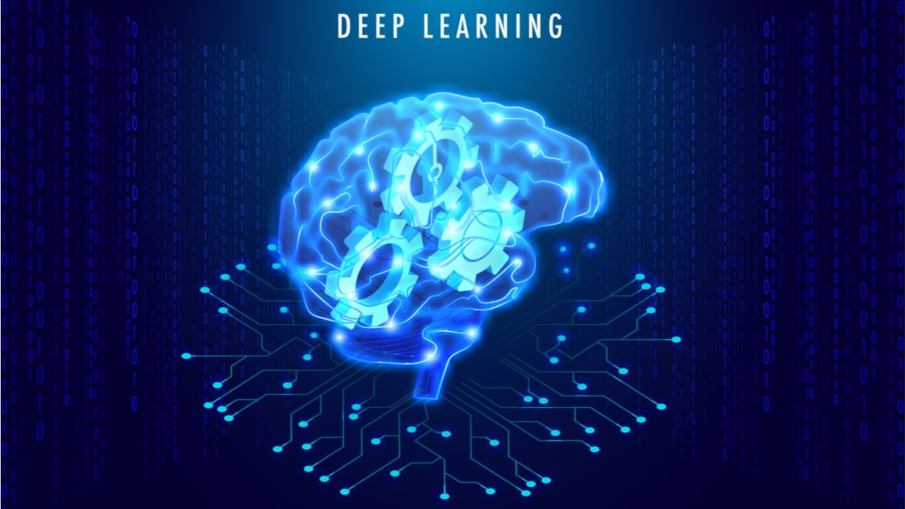
Grammatical Error correction using Deep learning
Applications of Machine learning
Presenting BY
Inchara(2244486)
Swapna bandi
Krishna veni

Slide 2
Introduction
Applications of Machine learning (ML) has numerous applications across various industries and domains. Here are some prominent examples
NLP, E-commerce, Finance, marketing, etc.
GEC benefits:
Personalization: Writing styles, genres, or domains, allowing for personalized error correction suggestions. For example, a system could be trained on academic writing to provide more targeted feedback for students or researchers.
Feedback Generation: Provide explanations or suggestions for corrections. This feedback can help users understand their mistakes and improve their writing skills over time.

Slide 3
Implementation Of Model
We are implementing tokenization, Encoding, and Decoding mechanism,
and RNN model for this.
Sequential model:->
Why Tokenization:Text to Sequence Conversion: Tokenization converts raw text data into sequences of integers, where each integer represents a unique token (word or character) in the vocabulary.
Padding and Truncation:Tokenization on tools in TensorFlow.keras often include options for padding or truncating sequences to ensure they have uniform length
Vocabulary Generation: Tokenization also involves generating a vocabulary, which is a mapping of tokens to their corresponding integer indices.

Slide 4
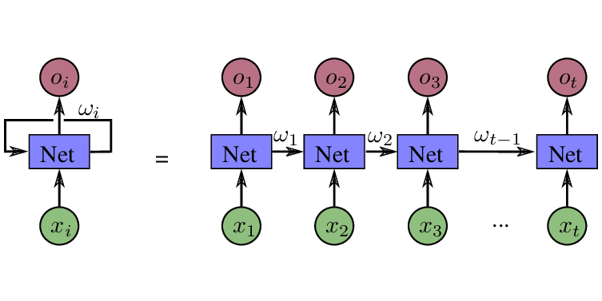
RNN Model
Recurrent neural networks
Output of the previous step is fed as input to the current step.
Why Recurrent Neural Network?

Slide 5
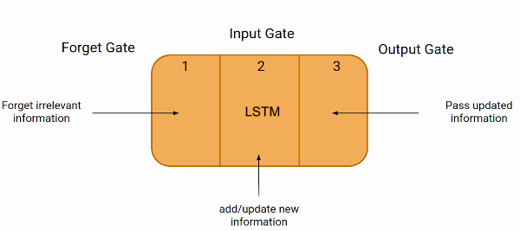
LSTM and Validation
Long Short term memory(LSTM): used in RNN architecture It excels at capturing long-term dependencies, making it ideal for sequence prediction tasks
Training and testing->epochs, activation function,optimization,batch size etc

Slide 6
Accuracy and results
Accuracy: This is a measure of the proportion of correct predictions made by the model overall predictions made. Accuracy can be calculated as:
Accuracy=Total number of predictions
Number of correct predictions
Validation Accuracy: This is the accuracy of the model on a separate dataset called the validation set. During the training process, the model is trained on the training dataset, and its performance is monitored on the validation dataset

Slide 7
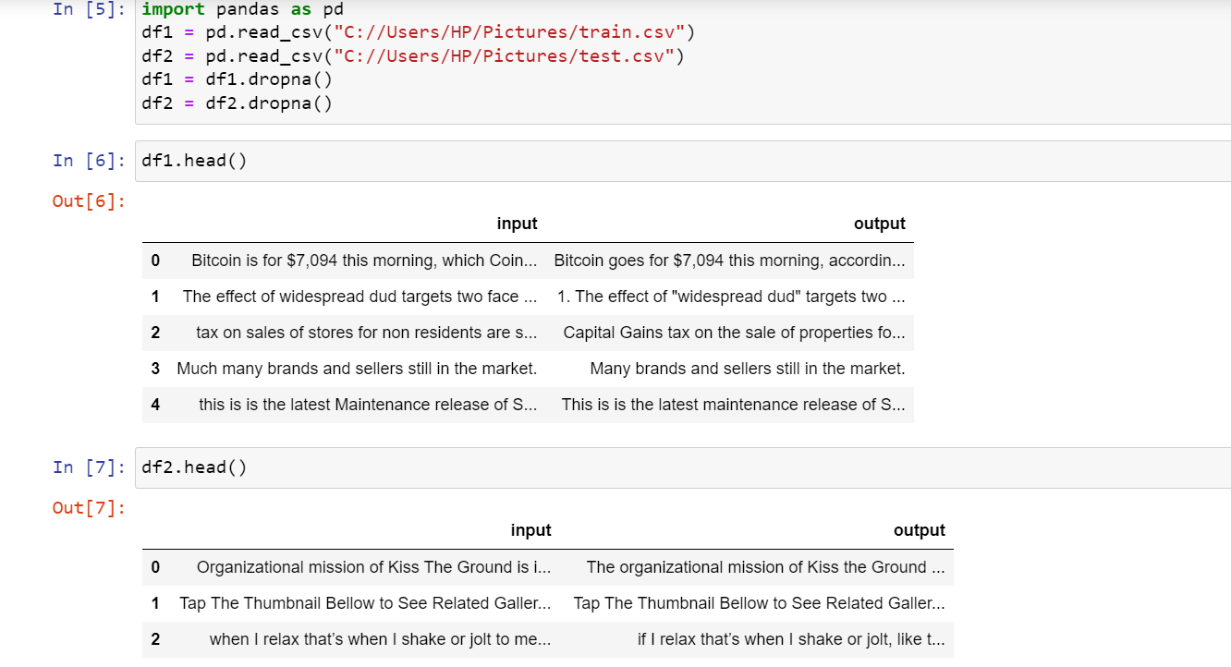
Code Snippet 1

Slide 8
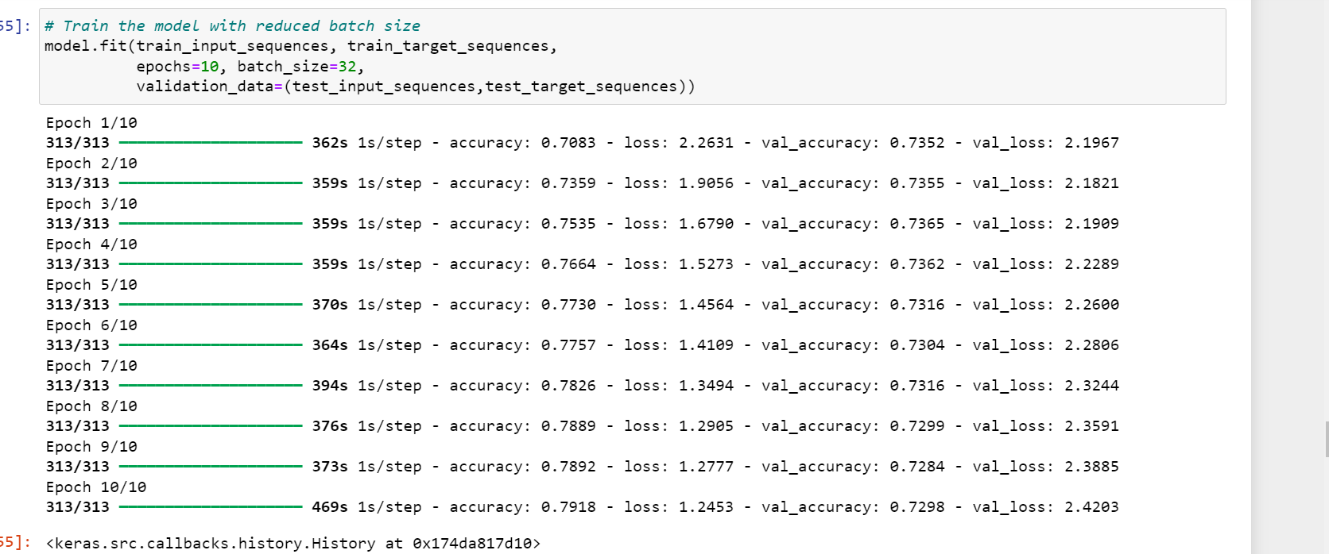
Code snippet 2

Slide 9
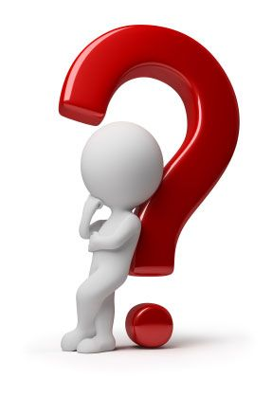

Slide 10


